Slide 1
Winter Park High School
BANDS

Slide 2
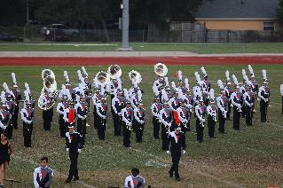
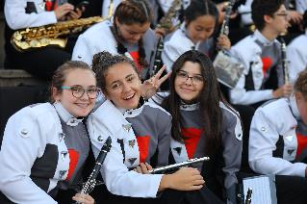
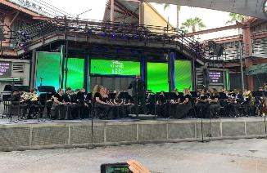
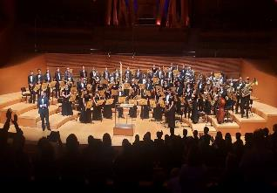
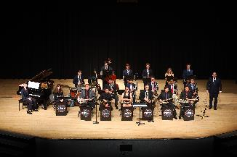
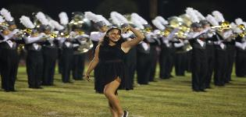
WELCOME!

Slide 3
Why Band at Winter Park HS?
Long Tradition of Excellence in the state of Florida and around the country. This coming school year is the 81st year of the Band program at Winter Park.
Outstanding musical opportunities and experiences.
Travel (DC, NYC, LA, Chicago – 2021 Spring Trip)
Festivals, parades, special performances
One of the very best peer groups in the school.
Why not? You have been building a skill for a number of years in middle school now. Put that time and effort to good use by continuing to refine your craft. Many people who put down their instrument after middle school wish they hadn’t later in life!

Slide 4
Band Offerings for 9th Grade
Concert Band
No Audition – only successful completion of 8th grade and experience on a wind instrument or percussion.
Meets during 7th period each day – Main Campus.
Students are transported by bus each day from Freshman Campus.
Full participation in all performances, MPA, etc.
Only open to 9th grade Band students.

Slide 5
Band Offerings for 9th Grade
Wind Symphony
Audition required – took place April 13 – 16.
Freshman CAN and DO make Wind Symphony!
Must also be enrolled in Concert Band – the exception being those who are enrolled in the Freshman Jazz Band. Study Skills waived.
Meets during 6th period each day – Main Campus.
Students are transported by bus each day from Freshman Campus.

Slide 6
Band Offerings for 9th Grade
Freshman Jazz Band
No Audition. No jazz experience required.
Must be enrolled in either Concert Band and/or Wind Symphony.
9th Grade “Study Skills/Freshman Experience” class is waived for those enrolled in Freshman Jazz Band – based on academic history.
Meets during 5th period each day – Main Campus.
Students are transported by bus each day from Freshman Campus.

Slide 7
Band Offerings for 9th Grade
“Sound of the Wildcats” Marching Band
ALL Winter Park Band students participate, grades 9-12.
Exceptions: health/physical limitations (needs administrative approval) or participation in a fall sport at Winter Park HS that has a conflicting schedule (most do not!).
Meets after school on Tuesday evenings and Thursdays right after school (more information on this later).
“In season” from late July until the first week of November.

Slide 8
Band Offerings for 9th Grade
Color Guard/Winter Guard
Open to all grade levels 9 – 12
No experience required.
6th period at the main campus
Color Guard meets after school on Tuesdays and Thursdays in the fall with the Marching Band.
Winter Guard season begins after Marching Band. Meets Tuesdays and Thursdays in the evenings for Winter Guard. Weekend performances.
Full year course, same as a concert band or jazz ensemble class.

Slide 9
Sample 9th Grade Schedules
A - No audition, No jazz
Concert Band – 7th period, main campus
B - No audition, participate in Freshman Jazz Band
Freshman Jazz Band – 5th period, main campus
Concert Band – 7th period, main campus
C – Successful Audition for Wind Symphony, no jazz
Wind Symphony – 6th period, main campus
Concert Band – 7th period, main campus
D - Audition for Wind Symphony, participate in Freshman Jazz Band
Freshman Jazz Band – 5th period, main campus
Wind Symphony – 6th period, main campus

Slide 10
Common Misconceptions
Band and IB or AP classes conflict.
In reality, over 95% of our Band students are enrolled in either IB or AP classes.
Yes, it may sound like a lot on paper, but the time commitment is very manageable with properly utilized time management strategies.
Band and sports conflict so I have to choose one.
Band and athletics work well together! We have just about every school sports program represented in Band each year. We will work with your practice schedule.

Slide 11
Common Misconceptions
Band (Marching Band) takes up my entire life.
Yes, you will be busier with Band than in middle school.
HOWEVER, it is less impactful than it seems, and far less impactful than other sports/activities you may choose.
The vast majority of days of the school year, the Band does not have after school commitments.
I can’t participate in Band because of the expense.
We never turn anyone away because of a financial limitation.
Fair Share payment plan spread throughout the school year.
There are many opportunities to raise money.
We will work with any student/family with need.

Slide 12
Financial Commitment
Varies – depending on your instrument.
$250 - $350 with payments spread across the school year. Installments made between May 2020 and March 2021.
Color Guard is more specialized, and incurs more of a cost due to hired instructors. Typically $600 - $700.
Why different amounts?
Fundraising opportunities.
Program ads/Sponsorships (summer)
Coupon Book, Butter Braid (fall)
Door-To-Door (Mandatory/February)

Slide 13
Band “Fair Share” 2020-2021
May 5 (Registration Google Form Due)
Band Registration Fair Share - $25
Band Camp Meals (optional) - $60
July 22
Fair Share Payment 1 - $75
Concert Attire Accessories/Marching Band Shoes – varies
Extra Show Shirt - varies

Slide 14
Band “Fair Share” 2020-2021
September 30
Fair Share Payment 2 - $50
Jazz Fair Share 1 (jazz students only) - $25
School Instrument Semester 1 Maintenance (if applies) - $60
January 6, 2021
School Instrument Semester 2 Maintenance (if applies) - $60
Jazz Fair Share 2 (jazz students only) - $25
March 3, 2020
Fair Share Payment 3 - $100 (this occurs right after our “Door-2-Door” fundraiser where the students typically earn $75 - $80)

Slide 15
Instruments
Students provide their own small instruments:
Flute
Oboe *
Clarinet
Alto Saxophone
Tenor Saxophone*
Trumpet
French Horn *
Trombone
Percussion Sticks & Mallets
(* there is a limited inventory of school instruments)

Slide 16
Instruments
Students are provided school instruments for the larger equipment:
Bassoon
Bass Clarinet
Baritone Saxophone
Euphonium
Tuba
Concert Percussion
Marching Instruments (Sousaphone, marching baritones, mellophones, drumline, marimbas, etc.)

Slide 17
Calendar Overview *pending instructions from OCPS*
Summer
Sectionals
Optional, but highly recommended.
Great transitional activities for incoming freshman students.
Marching Band Camp
Two weeks in late July
July 20 – 23 & July 27-30
See Charms calendar for complete schedule.

Slide 18
Calendar Overview
Fall
Marching Band Rehearsals (Tuesday evening & Thursday afternoon)
Friday evening Football Games
Marching Band MPA (Saturday in early November)
Fall Concert (concert bands/jazz bands)
All-State Band & Orchestra/Jazz Band Auditions (optional)
All-County Band/Jazz Band Auditions (optional)
Fall Festival of Bands (Feeder middle schools, Wind Symphony, Marching Band)
Night of Jazz (Feeder middle schools, jazz bands)

Slide 19
Calendar Overview
Winter
Winter Concert (concert bands/jazz bands)
Winter Park Christmas Parade
Baldwin Park Holiday Parade
Winter Guard FFCC performances
All-State (for those who qualify)
All-County Band (for those who qualify)
Jazz Band District MPA
Solo & Ensemble District MPA
Guest Conductor Workshop/Pre-MPA
Concert Band MPA

Slide 20
Calendar Overview
Spring
Solo & Ensemble State MPA
All County Jazz (for those who qualify)
Wind Symphony/Jazz Ensemble I Auditions for the following school year
Lakeside Jazz Festival
Spring Concert (concert bands/jazz bands)
Color Guard Showcase

Slide 21
Website
WinterParkHSBand.com

Slide 22
Charms
Primary Method of Communication between Directors and Parents/Students in addition to website.
Will be available to incoming students and families after Registration forms due date.
WWW.CHARMSOFFICE.COM
Enter/Login
Parents/Students/Members
School Code: WINTERPARKHSBAND
Student ID is initial password, then unique password
Do not use “Email Staff” – not OCPS mail compatible

Slide 23
Important Dates
Band Registration Google Form Due
Tuesday, May 5
Not the same as “course registration” done back in January.
Please fill out form thoroughly and completely!
2020/2021 Band Registration Form

Slide 24
Important Dates
Meet and Greet Sectional Zoom Meetings
Schedule TBA
Informal Zoom meetings so students can begin to get to know each other for the upcoming school year
Will begin in the weeks after Band Registration Google Form is due and we have contact information for incoming and returning students.

Slide 25
Important Dates
Summer Sectionals
Pending access to instruments for summer check-out.
Varies from section to section.
Schedule for summer sectionals will *hopefully* be established prior to Last Day of School.
Not “mandatory,” but students should attend if they are in town. They are a huge benefit to the over success of the individual student and the Band as a whole, and make band camp much more enjoyable!

Slide 26
Important Dates
Marching Band Camp Week One
Monday, July 20
Color Guard & Percussion 9 AM – 12 PM
Tuesday, July 21
Color Guard & Percussion 9 AM – 12 PM
New Marchers & Leadership 9 AM – 12 PM
Wednesday, July 22
ALL SOTW 9 AM – 5 PM
Lunch will be served here on campus for those who purchased Band Camp Meals.
Thursday, July 23
ALL SOTW 9 AM – 5 PM
Lunch will be served here on campus for those who purchased Band Camp Meals.

Slide 27
Important Dates
Marching Band Camp Week Two
Monday, July 27 – Friday, July 31
ALL SOTW students each day
9 AM – 9 PM
Students bring own lunch.
Dinner provided for students who purchased Band Camp Meals.
Mandatory Band Booster Meeting – Friday, July 31, 6:30 PM
“Premiere Show” on Friday, July 31 beginning at 8:00 PM.

Slide 28
Contacts
Michael Clemente
Director of Bands
Michael.Clemente@ocps.net
Daniel Smith
Associate Director of Bands
Daniel.Smith2@ocps.net

Slide 29
Contacts
Natalie Storch
Band Booster President
Band Booster related information, volunteering questions
njstorch@mac.com
Mary Beth Johnston
Band Treasurer
All financial related questions
mbkjohnston@gmail.com

Slide 30
Questions?

